Slide 1
Searching and Sharing of Knowledge Reference managers, learning tools
2024

Slide 2
Reference
managers

Slide 3
Reference managers
A reference manager is a software package that allows scientific authors to collect, organize, and use bibliographic references or citations.
The terms citation manager or bibliographic management software are used interchangeably.

Slide 4
Reference managers
Mendeley
Zotero
EndNote
ReadCube Papers
Citavi

Slide 5
Mendeley

Slide 6
Mendeley
Mendeley is a reference manager and academic social network that can help you organize your research, collaborate with others online, and discover the latest research.
Use Mendeley to:
Automatically generate bibliographies
Collaborate easily with other researchers online
Easily import papers from other research software
Find relevant papers based on what you’re reading
Access your papers from anywhere online

Slide 7
Mendeley
Mendeley can significantly speed up the process of writing your own papers. It helps you to gather literature in one place. The Mendeley Cite allows you to:
quickly and easily cite materials that you’ve added to your Mendeley library
Generate a full bibliography of the materials you’ve referenced in the paper.

Slide 8
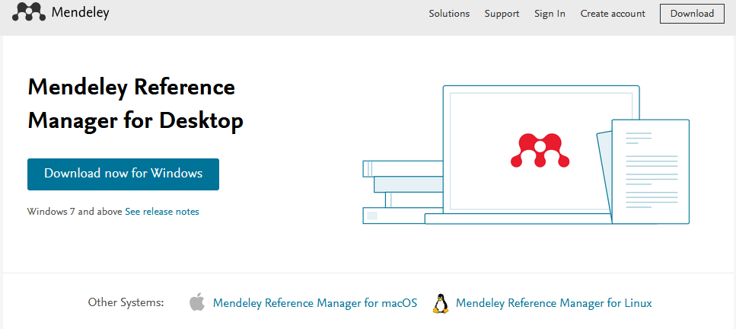
Step 1: Downloading
Basic option is free and can be downloaded from webpage: https://www.mendeley.com/download-reference-manager/

Slide 9
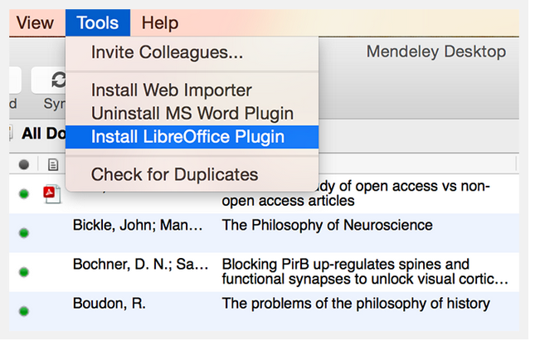
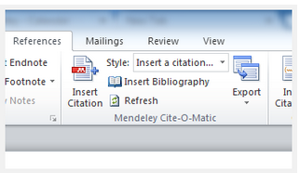
Step 2: Installing plug-in
Open the Tools menu and select the appropriate option.
Mendeley will detect which word processor(s) you have installed, so the options available to you may vary.
In Microsoft Word for Windows, the tool can be accessed via the References tab on the Ribbon. You should see a new set of tools for the Mendeley Cite-o-Matic

Slide 10
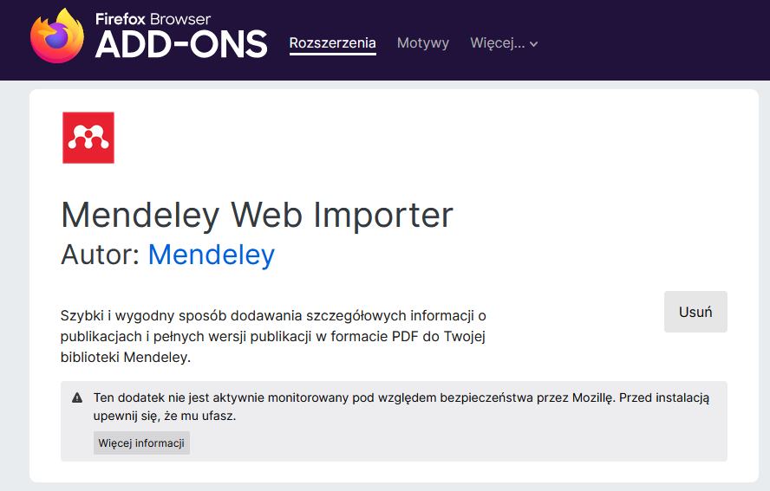
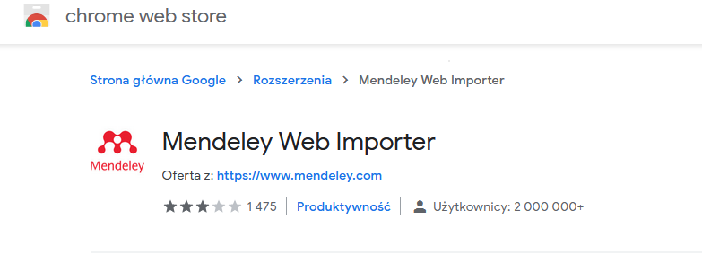
Step 3: Installing Mendeley plug-in at the web browser
Install plug-in to your browser to make gathering literature easier

Slide 11
Step 3: Installing Mendeley plug in in web browser
After installing it you will see the Mendeley icon on your browser tool ribbon

Slide 12
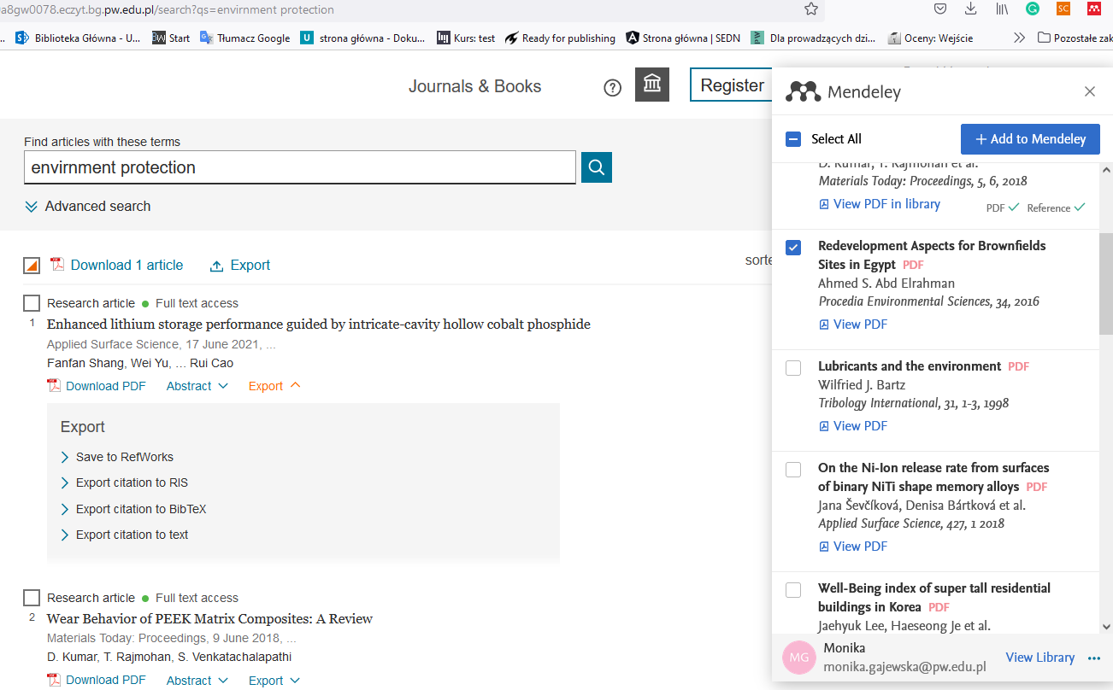
Step 4: Gathering literature
Make a search in database and then click on the Mendeley icon
Match the records which you would like to add to your library
Saved record you can see by clicking View Library

Slide 13
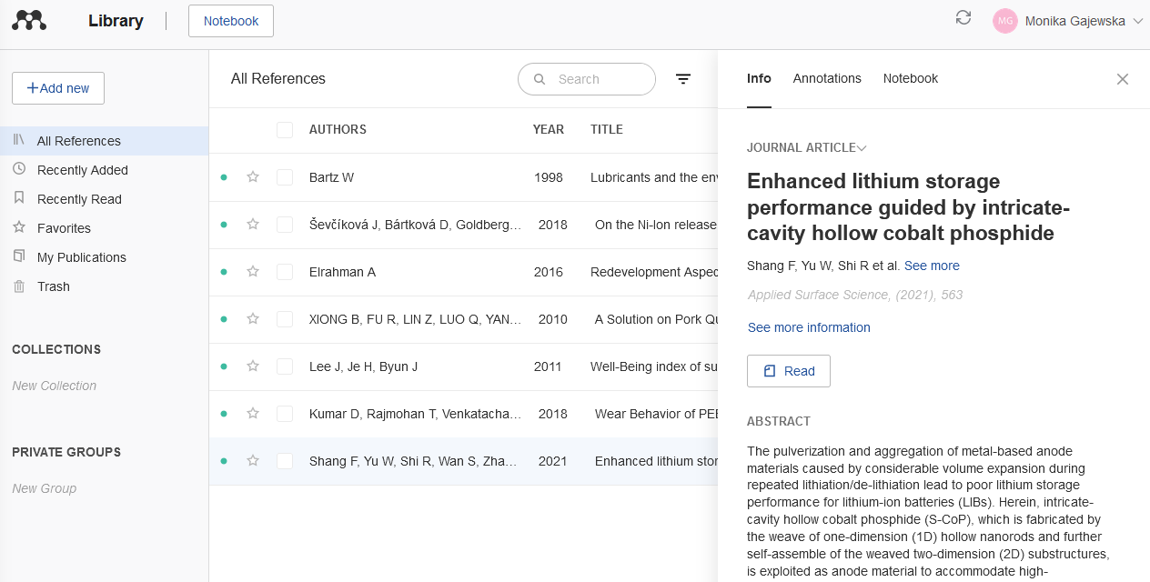
Step 4: Gathering literature
Added publications are visible in the main library.
Click on the specific one to see its details.

Slide 14
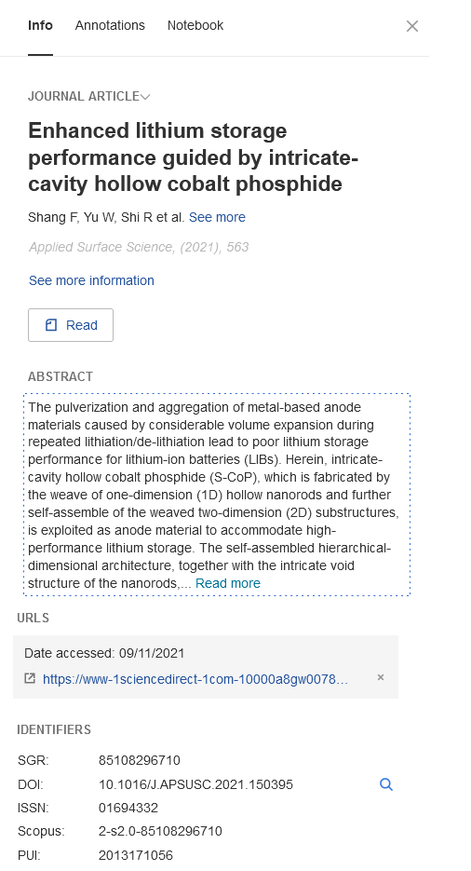
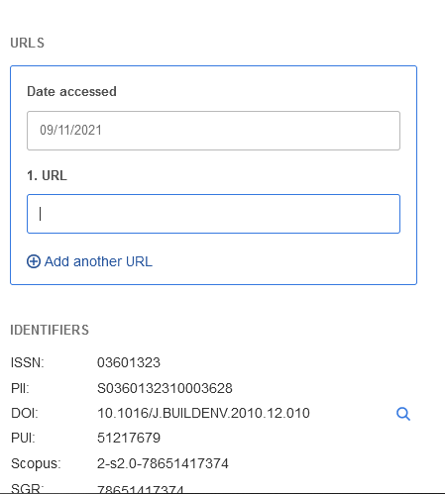
Check if all important metadata are filled in
If not, fill in them manually
Click on the selected field of bibliographic description

Slide 15
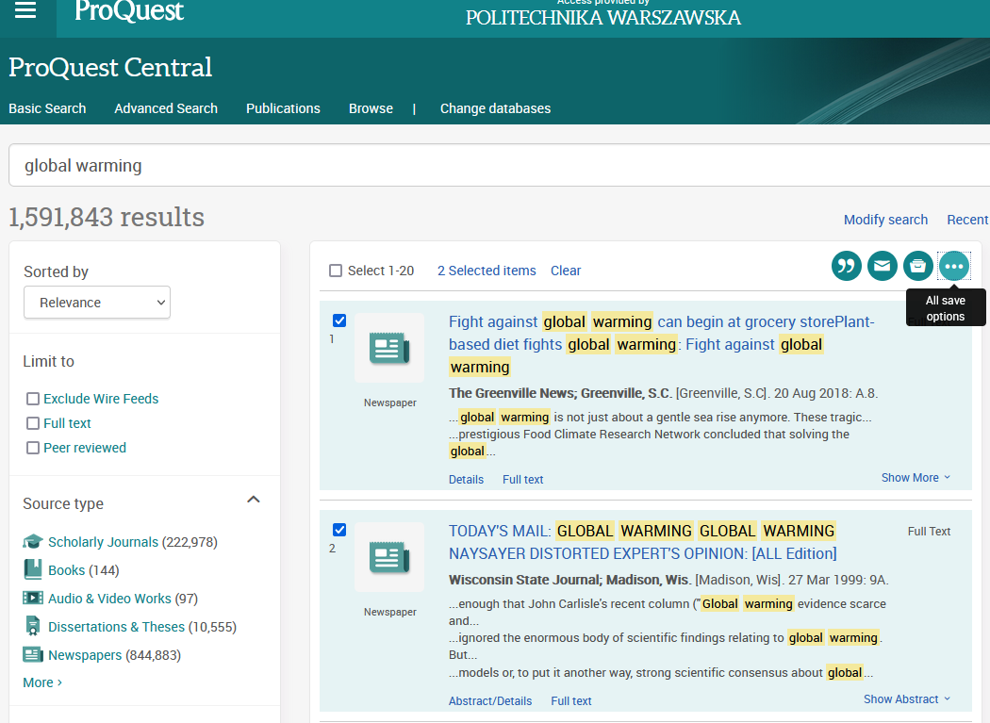
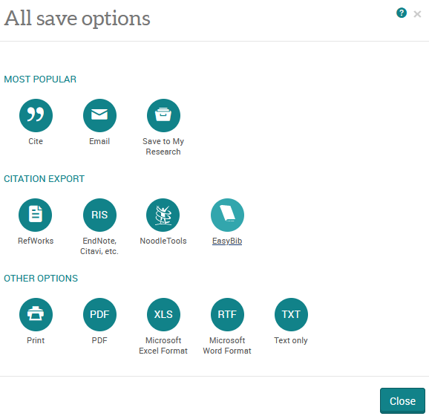
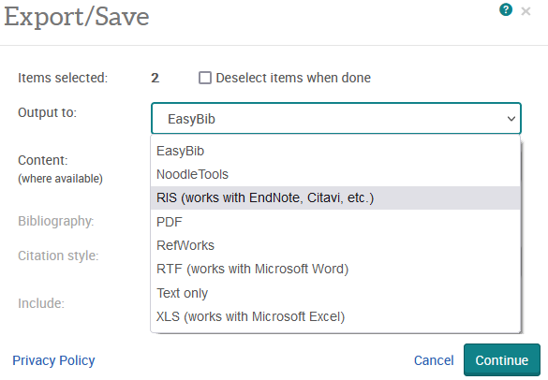
Step 4: Gathering literature
Almost all of the databases gives possibility of exporting references to ris or bib formats - it is another way on how you can easily import references to Mendeley
Select EasyBib
Select RIS format
Save the file on your desktop

Slide 16
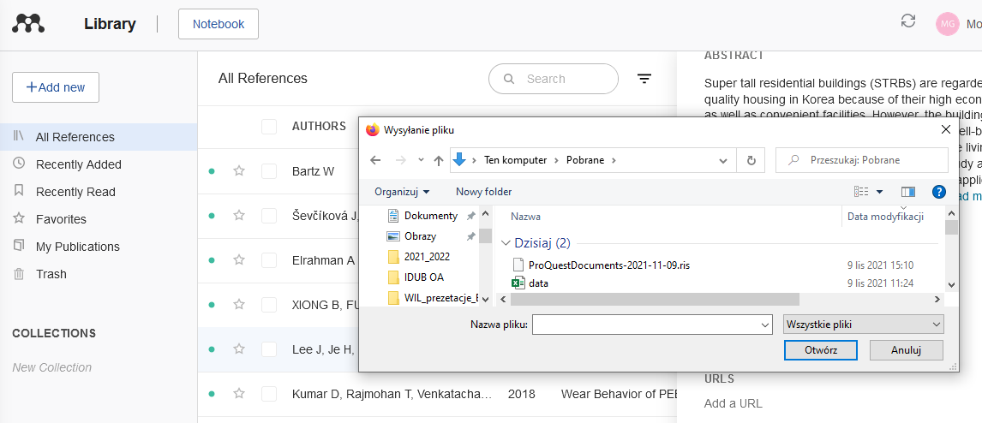
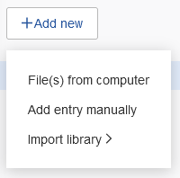
Step 4: Gathering literature
Select Add new in Mendely and then click on Files from computer
Open the RIS file

Slide 17
Step 4: Gathering literature
Select Add new in Mendely nad then click on Files from computer
Open the RIS file

Slide 18
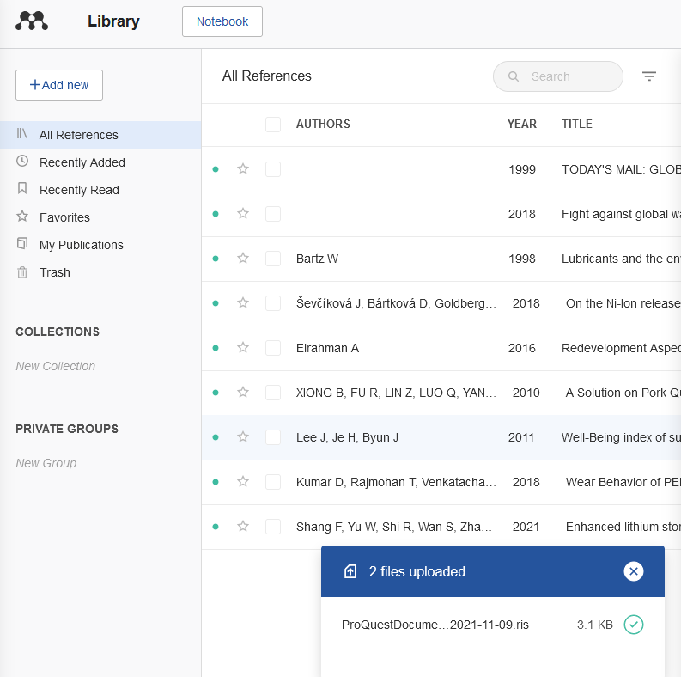
Step 4: Gathering literature
You will see the information that import has been successful

Slide 19
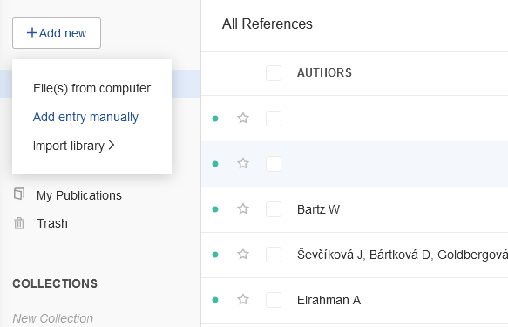
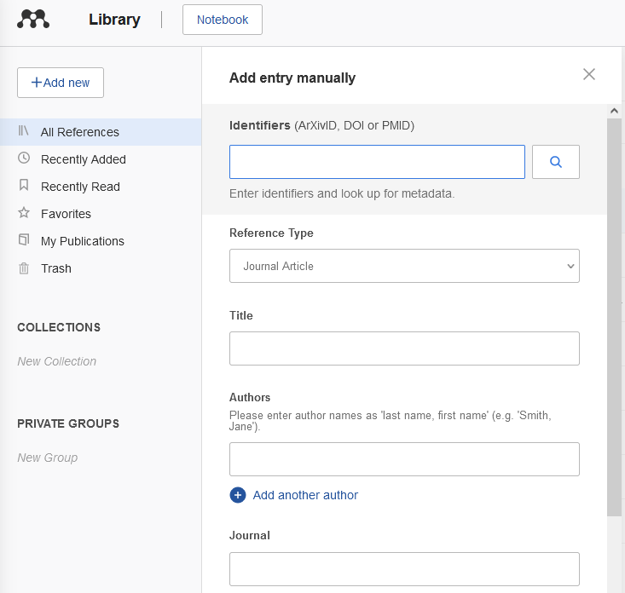
Step 4: Gathering literature
You can also add references manually by filling in all important data

Slide 20
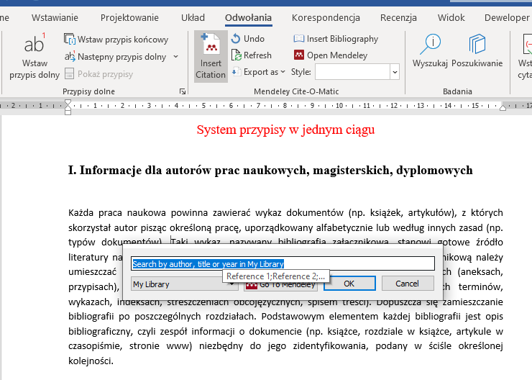
Step 5: Inserting a citation
Position the cursor where you want to insert your first citation and press the Insert Citation button on the toolbar.
The Mendeley Citation Editor popup will appear

Slide 21
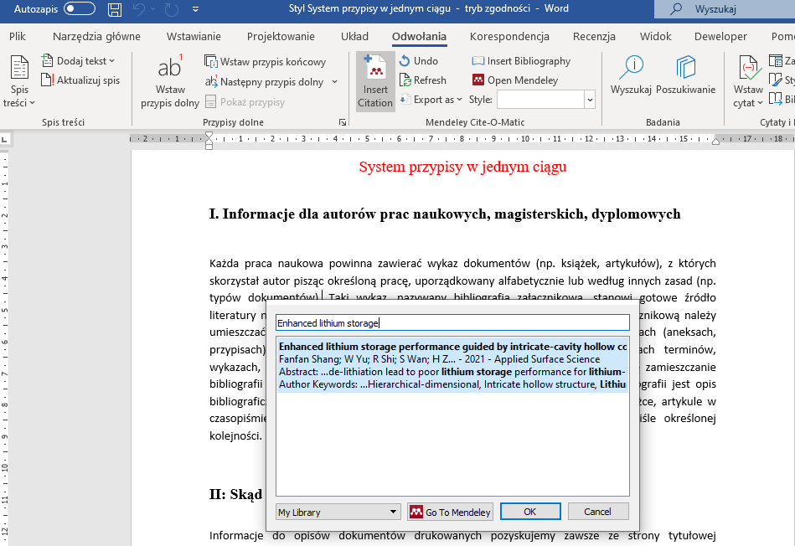
Step 5: Inserting a citation
Search your Mendeley library for the appropriate reference
Enter a search term and choose the desired reference from the list of results.
Press Ok to insert a citation to the selected reference.

Slide 22
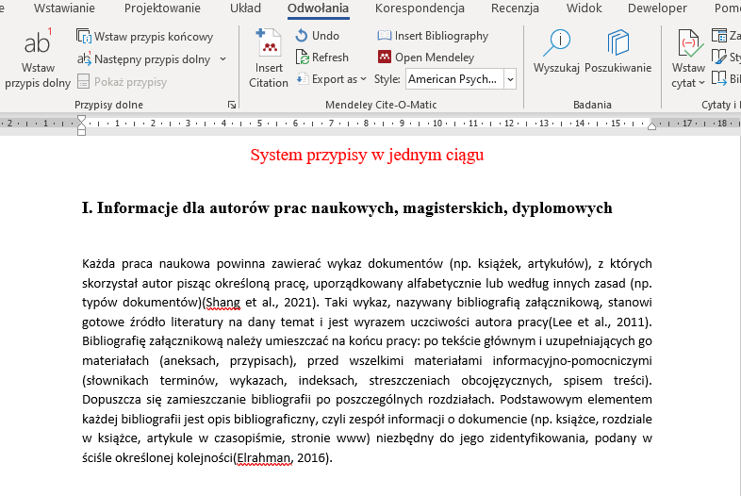
Step 5: Inserting a citation
Inserted references will be visible in the text

Slide 23
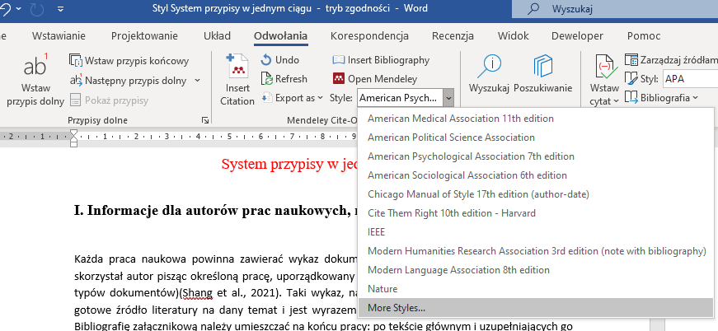
Step 5: Inserting a citation
Mendeley allows you to quickly change the Citation Style you’re using - even after you’ve finished adding all of your citations and creating your bibliography.
On the plugin toolbar, you'll find a button labelled 'Choose Citation Style' (it may read 'Select me to fetch the styles' depending on the operating system you're using). Click this button to open the Mendeley Citation Styles menu.

Slide 24
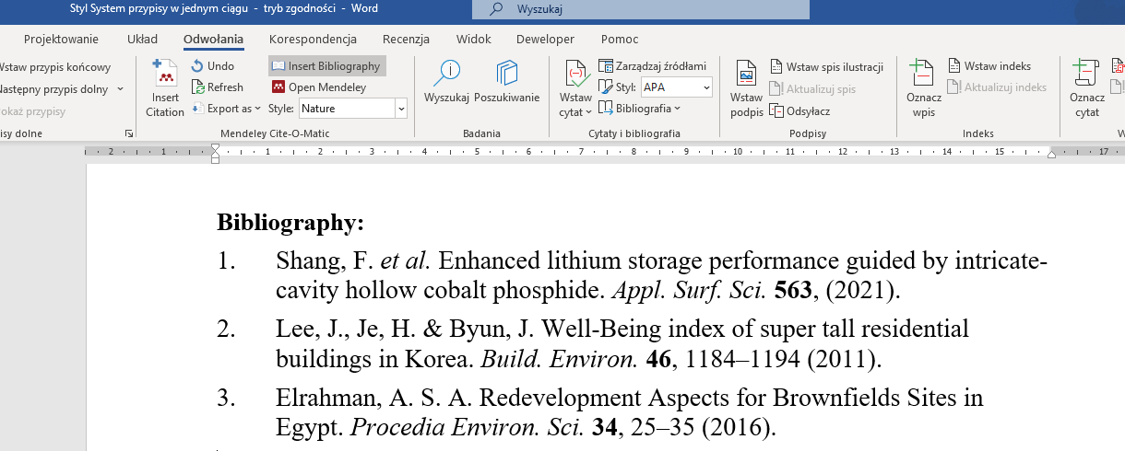
Step 6: Creating a bibliography
Once you’ve inserted all the citations you require, you can use the Mendeley plugin to automatically create a bibliography of all the materials you’ve cited.
Position the cursor where you want the bibliography to appear and press the ‘Insert Bibliography’ button on the plugin toolbar. Depending on the number of citations in the document, this process may take a few seconds to complete.

Slide 25
Zotero

Slide 26
Zotero - reference manager
Zotero is a free and open-source reference management software to manage bibliographic data and related research materials (such as PDF files).
Zotero features include web browser integration, online syncing, generation of in-text citations, footnotes, and bibliographies, as well as integration with Microsoft Word, LibreOffice Writer, and Google Docs.
Zotero is developed as a project by the non-profit Corporation for Digital Scholarship. It was originally created at the Center for History and New Media at George Mason University.

Slide 27
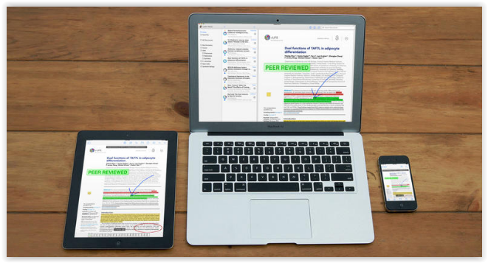
Zotero - reference manager
Automatic synchronization on all devices
Library items and notes are synced through the Zotero servers (unlimited storage), while attachment syncing can use the Zotero servers or your own WebDAV service to sync files such as PDFs, images, or audio/video.

Slide 28
What does Zotero do?
Zotero is, at the most basic level,a reference manager. It is designed to store, manage, and cite bibliographic references, such as books and articles. In Zotero, each of these references constitutes an item.
Zotero is a powerful tool for collecting and organizing research information and sources.

Slide 29
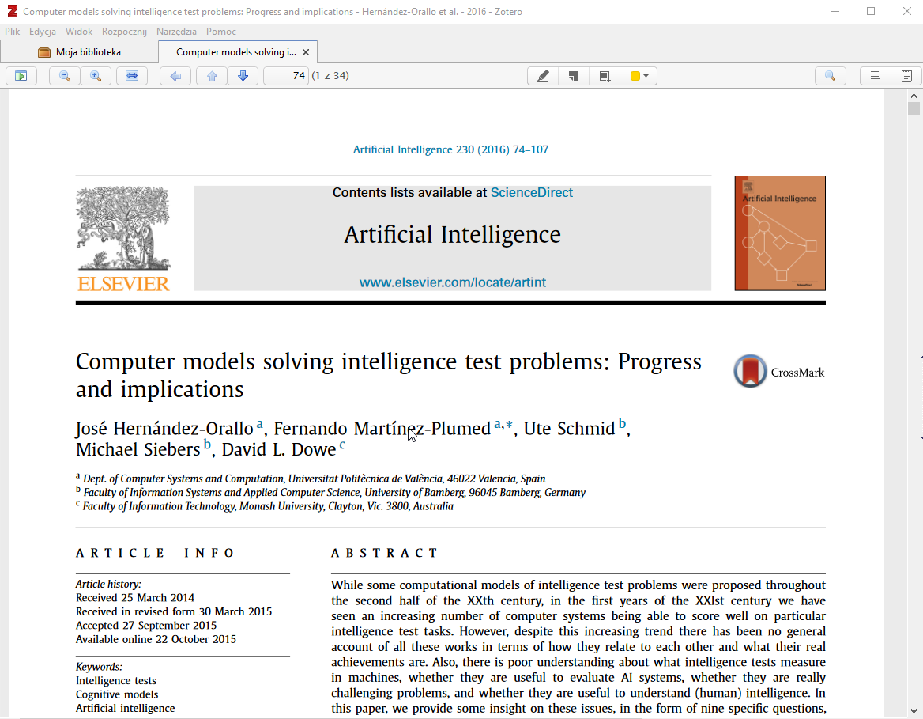
What does Zotero do?
A built-in PDF reader lets you mark up PDFs and then extract cited quotations and comments directly into notes or word processor documents.
Zotero can automatically add publication data by DOI or ISBN and find open-access PDFs when you don’t have access to a paper. You can create advanced searches and save them as auto-updating collections. When you open a paywalled page in your browser, Zotero can automatically redirect you through your institution’s proxy so that you can access the PDF.

Slide 30
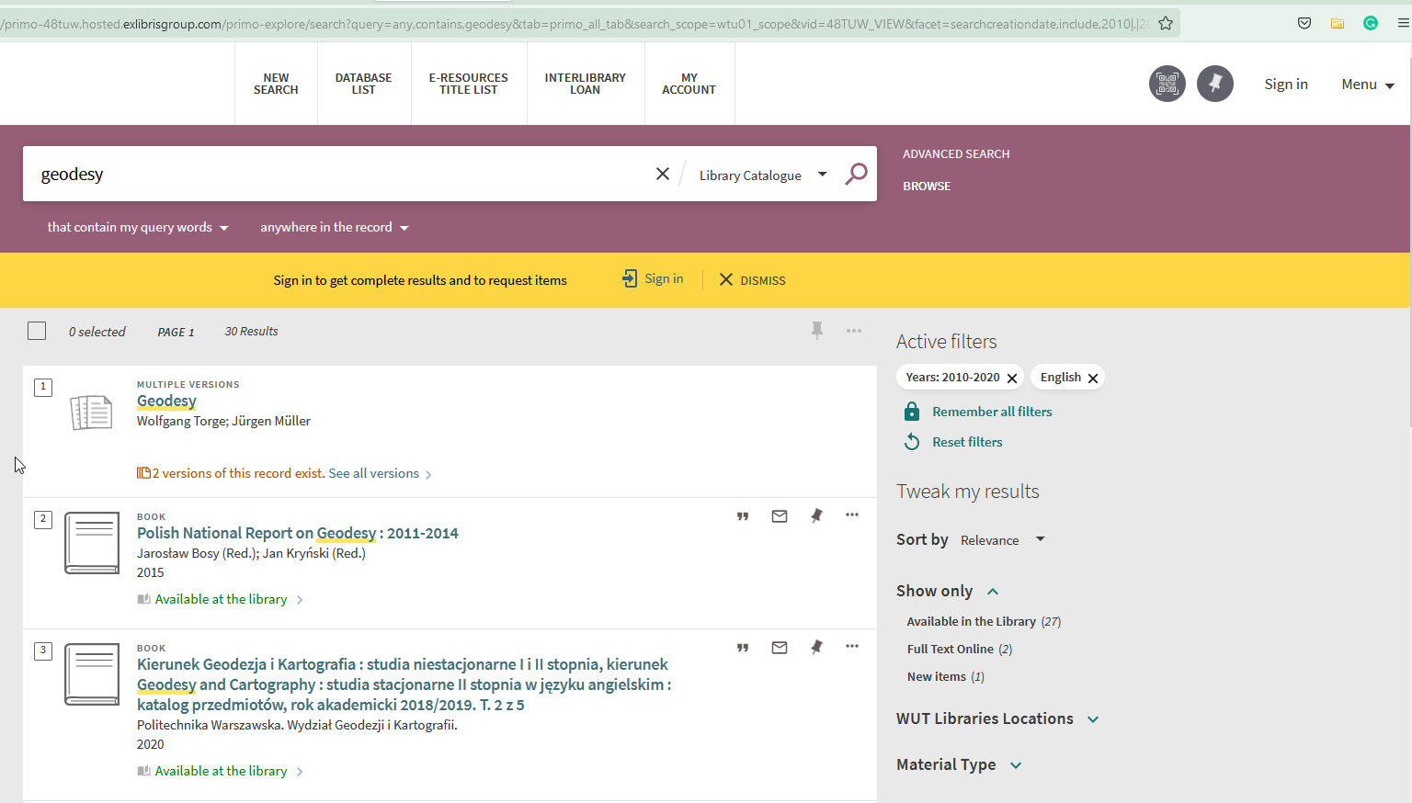
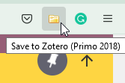
What does Zotero do?
Downloads bibliographic data from websites and on-line library catalogs

Slide 31
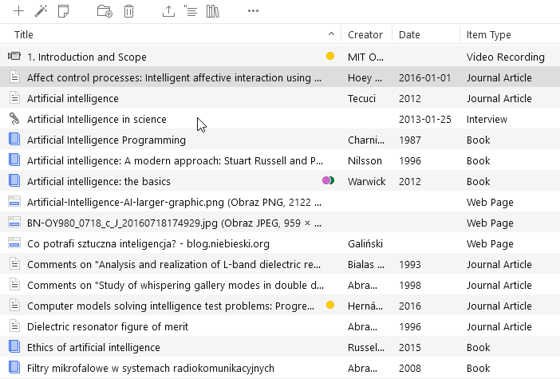
What does Zotero do?
Zotero allows you to create your own library of scientific materials collected while writing scientific papers

Slide 32
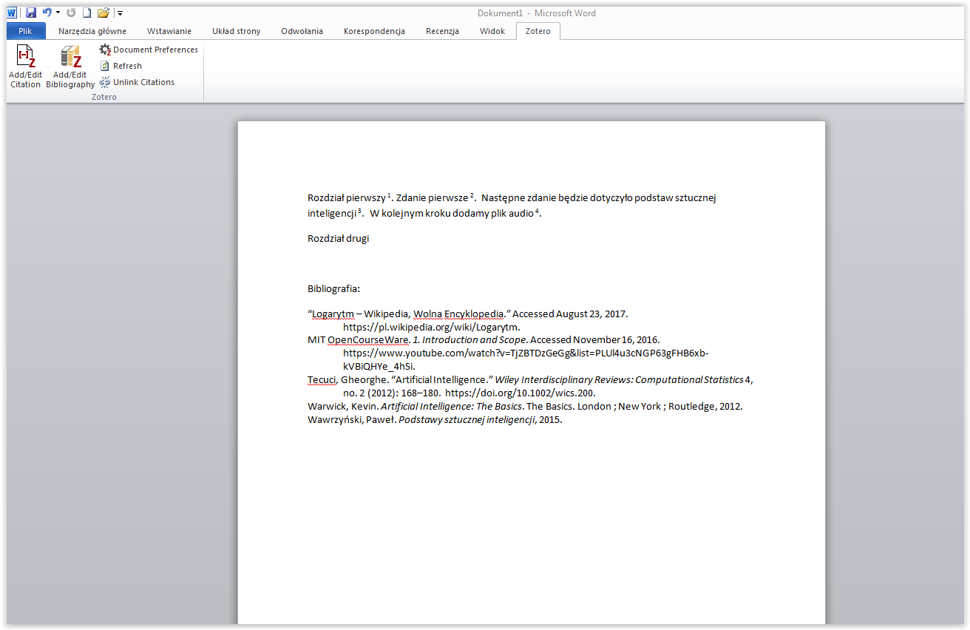
What does Zotero do?
Allows you to insert footnotes in research work and create an attachment bibliography in any style

Slide 33
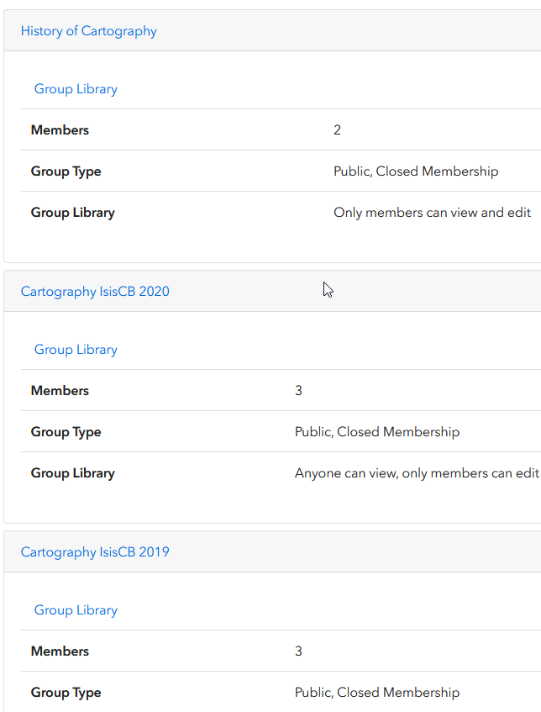
What does Zotero do?
Zotero users can create collaborative or interest groups. Shared group libraries make it possible to collaboratively manage research sources and materials, both online and through the Zotero client.
Zotero.org can be the hub of all your project group's research, communication and organization.

Slide 34
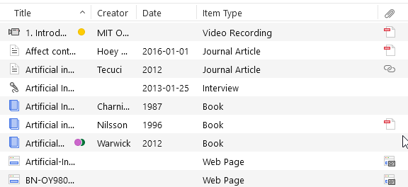
What kind of items are there?
Every item contains different metadata, depending on what type it is. Items can be everything from books, articles, and reports to web pages, artwork, films, letters, manuscripts, sound recordings, bills, cases, or statutes, among many others.

Slide 35
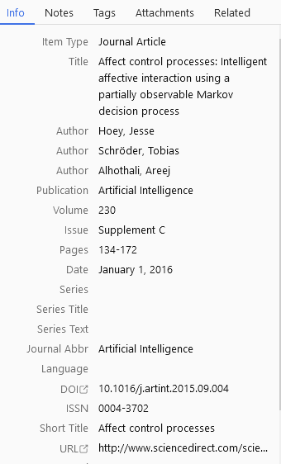
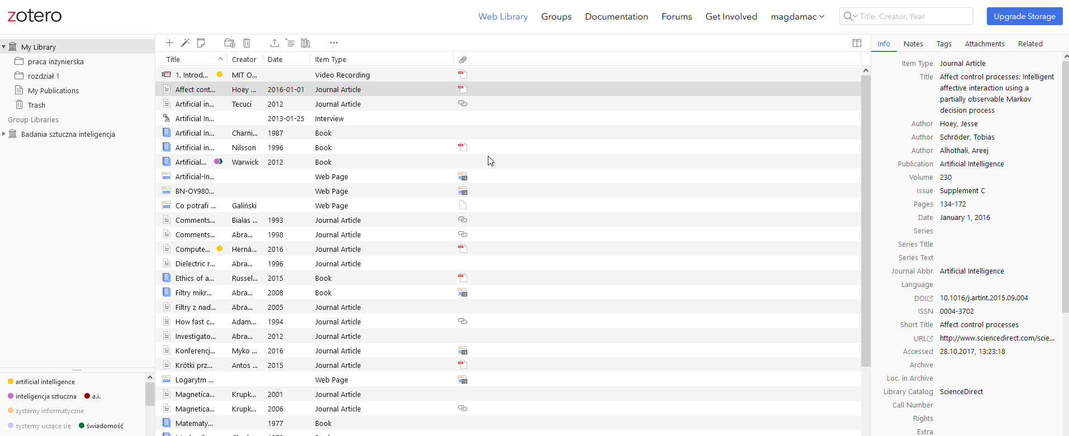
What can I do with the items?
Items appear in Zotero's center pane. The metadata for that item is shown in the right pane. This includes titles, creators, publishers, dates, page numbers, and any other data needed to cite the item.

Slide 36
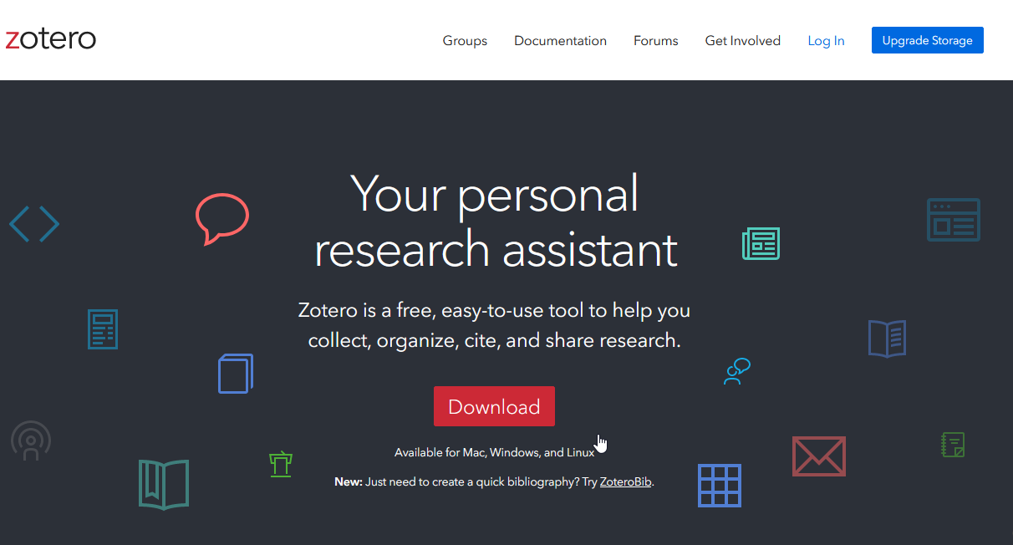
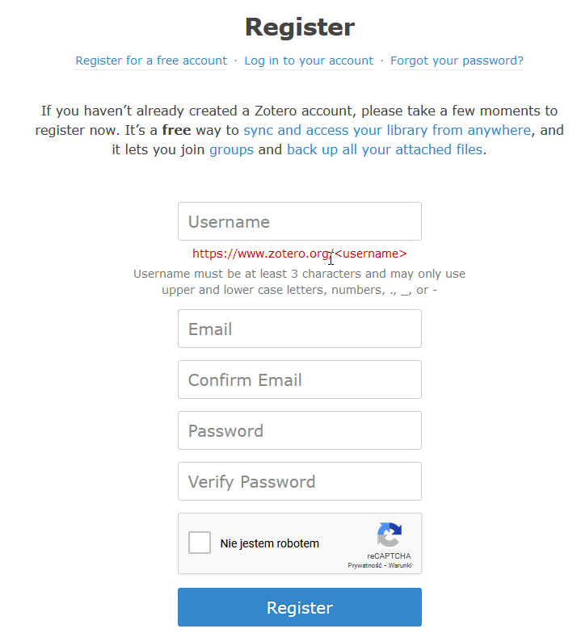
How to start?
zotero.org

Slide 37
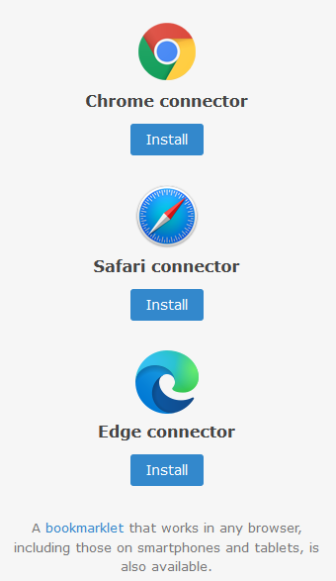
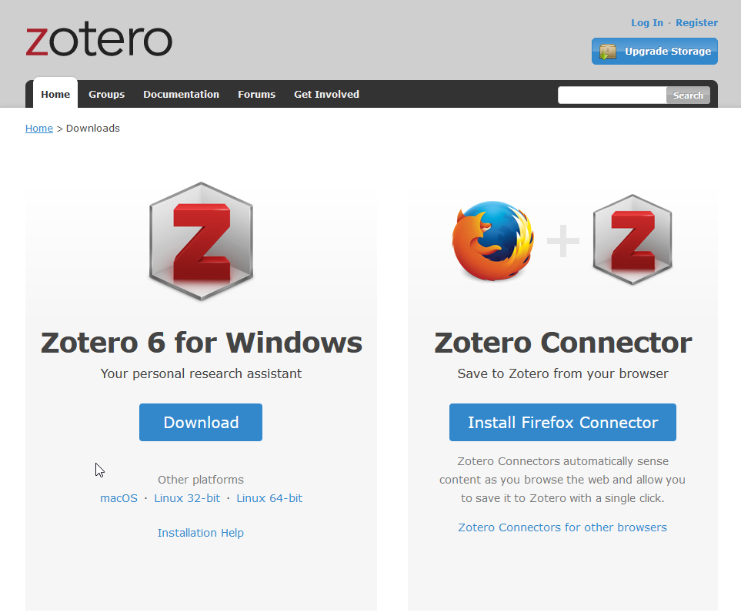
How to start?
You have two options:
you can download desktop application or use online app thru the web broweser

Slide 38
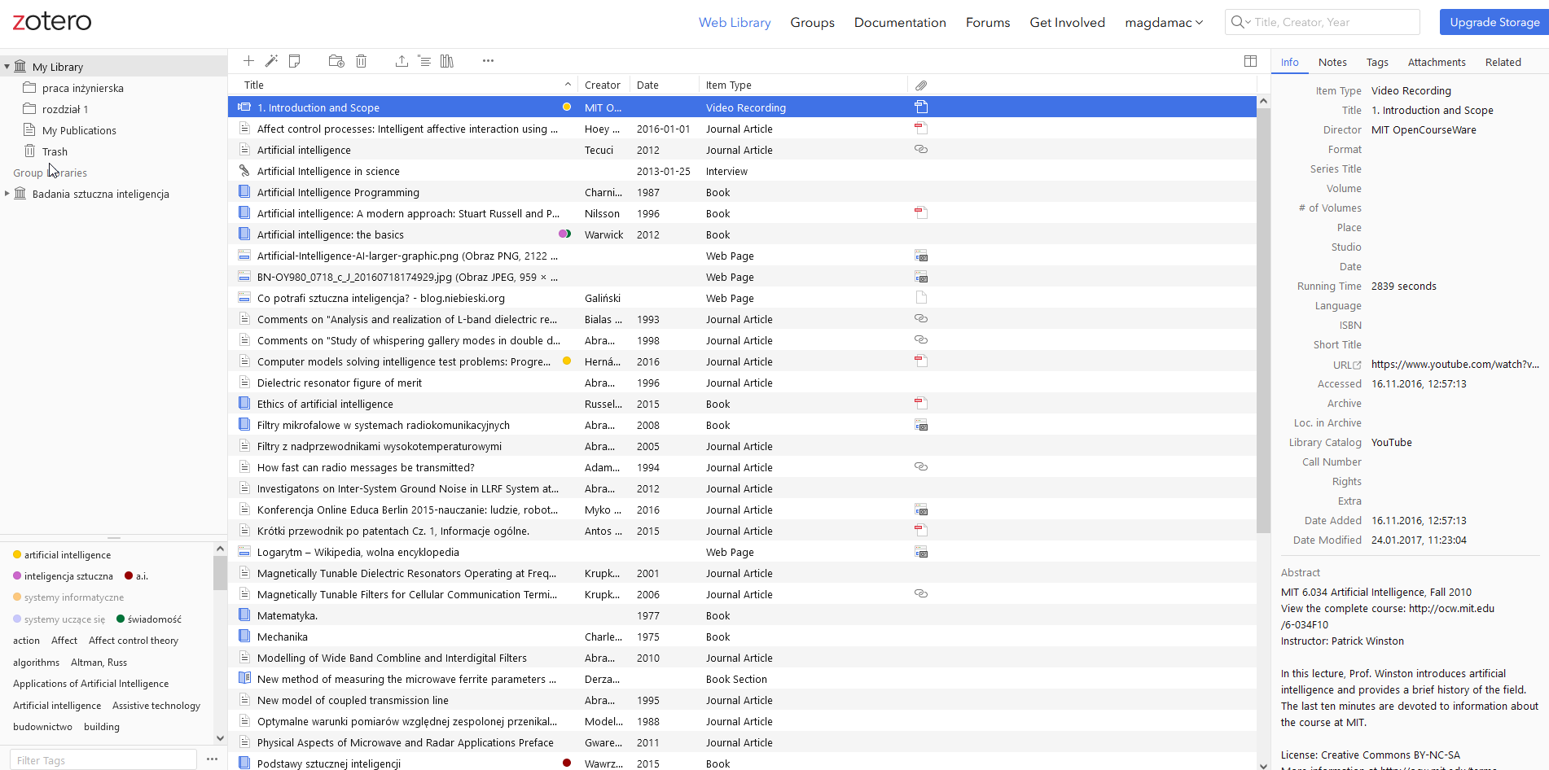
How to start?

Slide 39
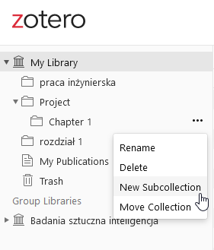
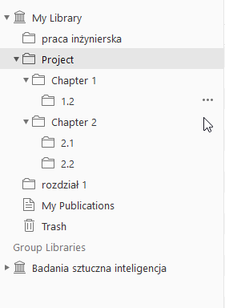
Organize Collections
Organize your collection
The left pane includes My Library, which contains all the items in your library. Right-click on My Library or click on the New Collection button ( above the left pane to create a new collection, a folder into which items relating to a specific project or topic can be placed).
Think of collections like playlists in a music player: items in collections are aliases (or “links”) to a single copy of the item in your library. The same item can belong to many collections at one time.

Slide 40
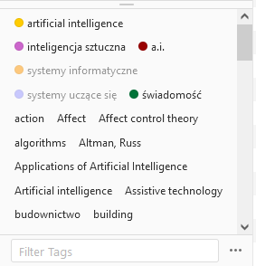
Organize Tags
Items can be assigned tags. Tags are named by the user. An item can be assigned as many tags as is needed.
Tags are added or removed with the tag selector at the bottom of the left pane or through the Tags tab of any item in the right-hand pane.
Up to 6 tags can be assigned colors. Colored tags are readily visible in the item list and can be quickly added or removed using the number keys on your keyboard.

Slide 41
Organize Searches
Quick searches show items whose metadata, tags, or fulltext content match the search terms and are performed from the Zotero toolbar.
Clicking the spyglass icon to the left of the search box opens the Advanced Search window, allowing for more complex or narrow searches.

Slide 42
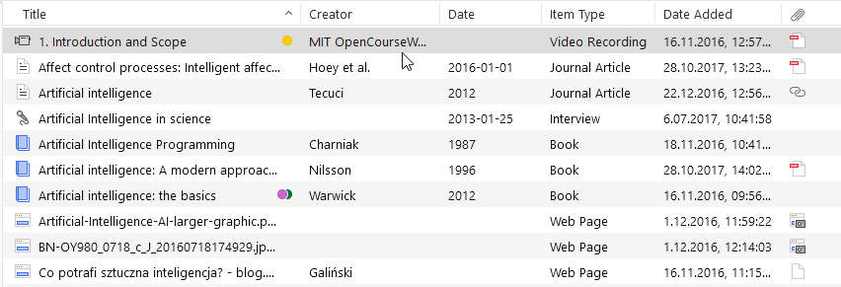
Collect Attachments
You can attach notes, files, and links to individual items.
These attachments appear in the center pane below their parent. You can show or hide attachments.

Slide 43
Collect Notes
Rich-text notes can be attached to any item through the Notes tab in the right-hand pane.
They can be edited in the right-hand pane or in their own window.
You can make New Note without attaching it to an item.

Slide 44
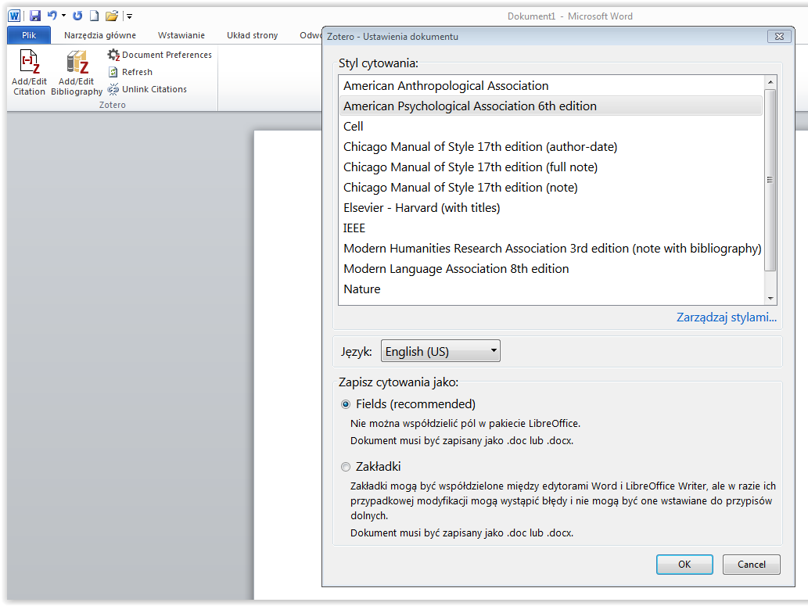
Adding citations
To insert a footnote, first start the Zotero program in the text editor (the icon is in the bar at the top) and then select Add / Edit Citation
Then select a citation style from the menu

Slide 45
Adding citations
this is what the finished citation looks like

Slide 46
Creating an attachment bibliography

Slide 47
Learning tools
Grammarly, DeepL,
Google Translator

Slide 48
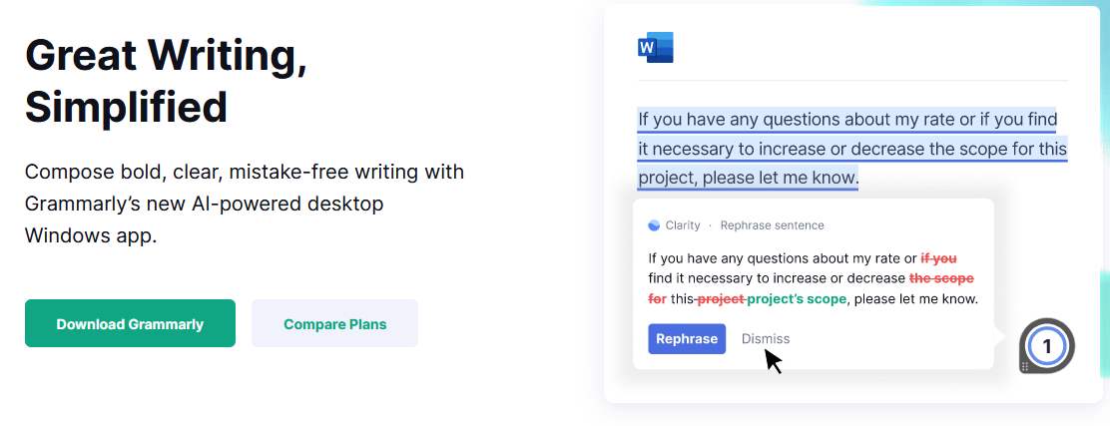
Grammarly
A tool for correcting linguistic errors in English texts. Grammarly checks grammar, punctuation, style, spelling.
Grammarly allows you to use functionalities that work directly when writing texts:
in a web browser
in Word
as a desktop application for Windows and macOS
and as a mobile app

Slide 49
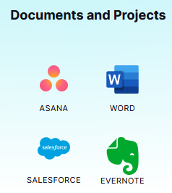
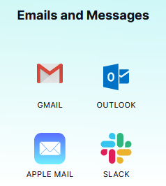
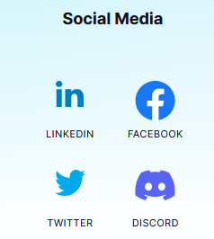
Grammarly
Grammarly enables you to work and proofread English when writing in desktop applications and websites - no matter if you are working with documents, using social media, working in an app or writing an email.

Slide 50
Why Grammarly?
With Grammarly, you will get detailed feedback on your writing and be able to apply the suggested prompts.
Your texts will be clear, convincing and concise with suggestions tailored to your writing goals.
You will tailor the feedback from Grammarly based on your goals, target audience, writing style and more.
You will see your prompts categorised to help you identify the strengths of your text.

Slide 51
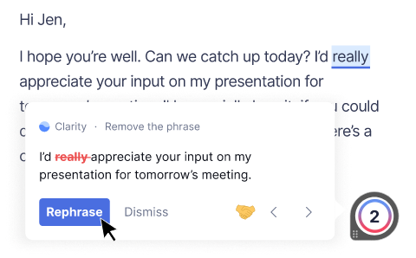
Grammarly Free vs. Grammarly Premium
Free version - provides artificial intelligence-based spelling and grammar checking. This allows Grammarly to catch more errors and any redundant elements.
Premium version (paid) - additionally includes an advanced punctuation check option, advanced grammar check, punctuation errors, sentence structure and sentence formation.

Slide 52
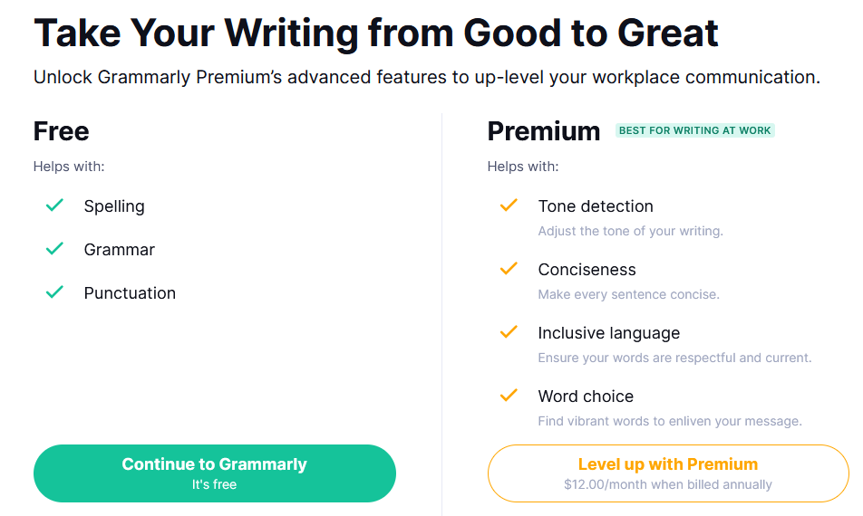
Grammarly Free vs. Grammarly Premium

Slide 53
Grammarly Premium
Grammarly Premium can provide you with very helpful feedback on your text. Grammarly Premium will correct errors regarding the use of the passive side, as well as catching classic errors in word choice.
It can also help with inconsistencies, such as the dilemma between the use of "e-mail" and "email" or "USA" and "U.S.A."
It can help when you want to adjust the style of your text (formal or informal). This is particularly useful if you are writing to a wide audience, from business people to friends and family. The programme will carefully analyse your vocabulary and suggest the best solution.

Slide 54
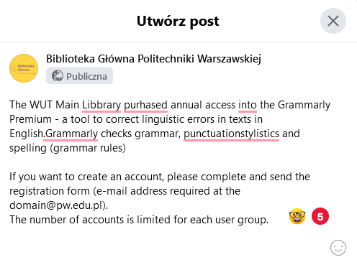
Grammarly - functions
When we start writing something (whether an email message or a post on FB), we will see the Grammarly icon in the text window. As you type, Grammarly will check everything in real time and highlight any mistakes. You will also see a message with the number of mistakes you have made.

Slide 55
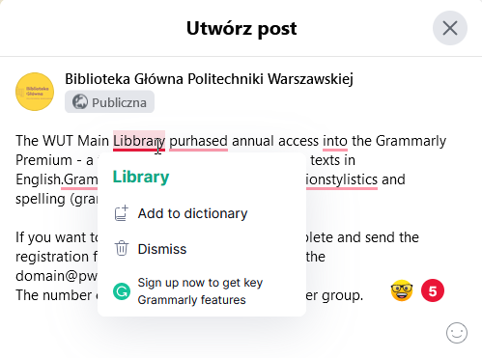
Grammarly - functions
When we click on the underline, we will be presented with the correct spelling/correction of the error suggested by Grammarly. Simply click on the correct word and the incorrect word will be replaced by the correct word.
The Grammarly's suggestion can also be rejected, and you can also add it to the dictionary if it is not a typo

Slide 56
Grammarly - functions
In addition to correcting spelling errors, Grammarly can indicate whether a space is needed in the text, for example.

Slide 57
Grammarly - functions
Grammarly displays definitions (option available after uploading the Grammarly plug-in to your web browser). Useful function for learning English

Slide 58
Grammarly

Slide 59
Grammarly

Slide 60
Grammarly

Slide 61
Grammarly
Ability to create your own dictionary (advanced vocabulary)

Slide 62
Grammarly
Language settings

Slide 63
Grammarly
Writing style settings and style corrections

Slide 64
Grammarly

Slide 65
Grammarly
Creating a new document
Uploading an existing document

Slide 66
Grammarly

Slide 67
Grammarly
When you are creating text , Grammarly corrects errors and shows them in its statistics.

Slide 68
Grammarly
When you want to add a document that already exists, such as a Word file, select Menu on the right side of the page

Slide 69
Grammarly
Choose Upload file

Slide 70
Grammarly
After uploading the file, we can set our own preferences to suit our style or audience, such as whether the text should be in a formal style, etc.

Slide 71
Grammarly

Slide 72
Grammarly will catch spelling and grammatical errors in your text but also find examples of misused commas and other types of punctuation. It will highlight these issues in red, but also show you how to write a sentence correctly.
Underlines in blue mean that Grammarly has noticed a sentence that is unnecessarily elaborate. You will find suggestions that can help you improve the sentence in a simple way.

Slide 73
Grammarly
The Overall score option will show the exact statistics of the text, such as:
number of characters
number of words
number of sentences
approximate time needed to read the text
approximate time needed to read the text aloud, and others.

Slide 74
Grammarly
In the menu on the right, we have access to all the prompts that Grammarly offers us:
Correctness
Clarity of the text
Effectiveness of the text
Message
Stylistics

Slide 75
Grammarly
In the Grammarly Premium version, we have a Plagiarism option available. With this option, Grammarly will compare your text with billions of web pages and academic papers in private databases, looking for sentences or paragraphs that have been published elsewhere.
Grammarly will flag text that may need to be cited and provide links to sources where matching text is found. The user will also receive an overall assessment of the originality of their document.

Slide 76
Free Version
Premium Version
Źródło: Wikipedia contributors. (2022, May 7). Free Comic Book Day. In Wikipedia, The Free Encyclopedia. Dostęp 7 maja 2022 r. Dostępny w Internecie: https://en.wikipedia.org/w/index.php?title=Free_Comic_Book_Day&oldid=1086622180

Slide 77
Grammarly Premium WUT

Slide 78
Grammarly Premium WUT
https://forms.office.com/pages/responsepage.aspx?id=nCJQO3jNiEWbz5e3Yp4vD1rwU5-tN_1EovmEVDJJ1EpURUdEQzhNRDRCSkFDS0FKTE9PSjFCM1pVMS4u

Slide 79
Grammarly – account

Slide 80
Grammarly – account
If you want to create an account, please complete and send the registration form (e-mail address required at the domain@pw.edu.pl).

Slide 81
Grammarly – account

Slide 82
My Grammarly

